Slide 1
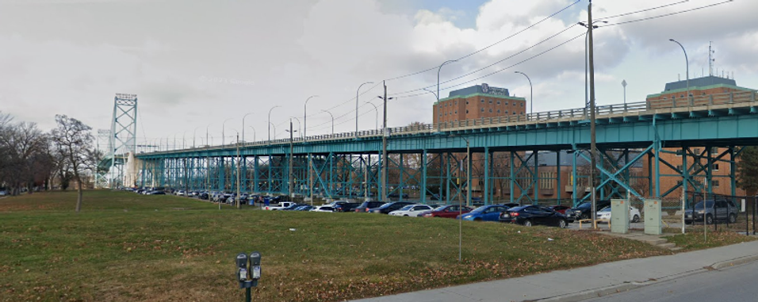
Bridging to the Future: The Ambassador Bridge - Plans, Innuendo and Rumours

Slide 2
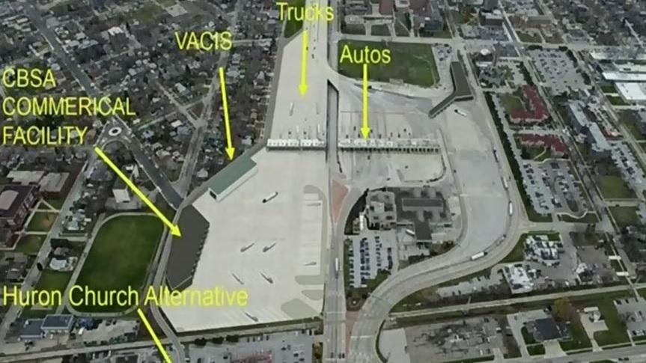
The Plan
The original twin span proposal that was approved in the Orders in Council was really two permits.
  One for a bridge
  One for a truck plaza
It set a series of conditions to move forward.
After the second span permit expired the other plaza permit which had no expire remained.

Slide 3
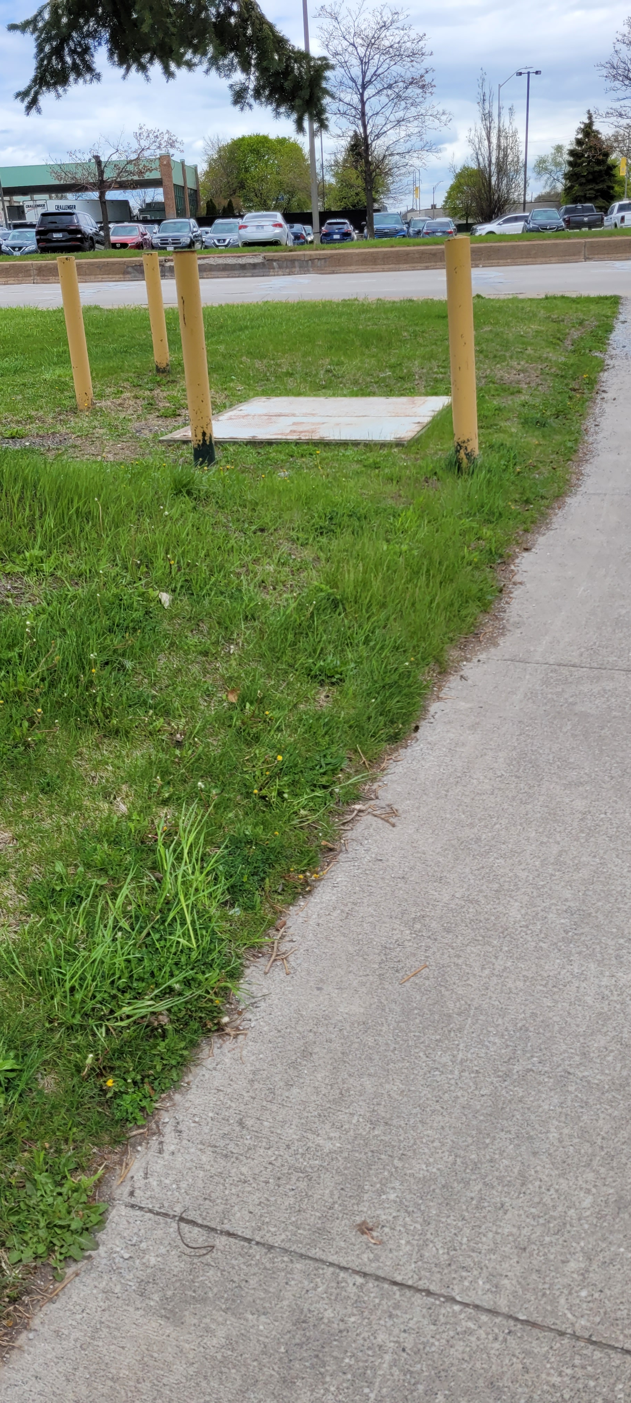
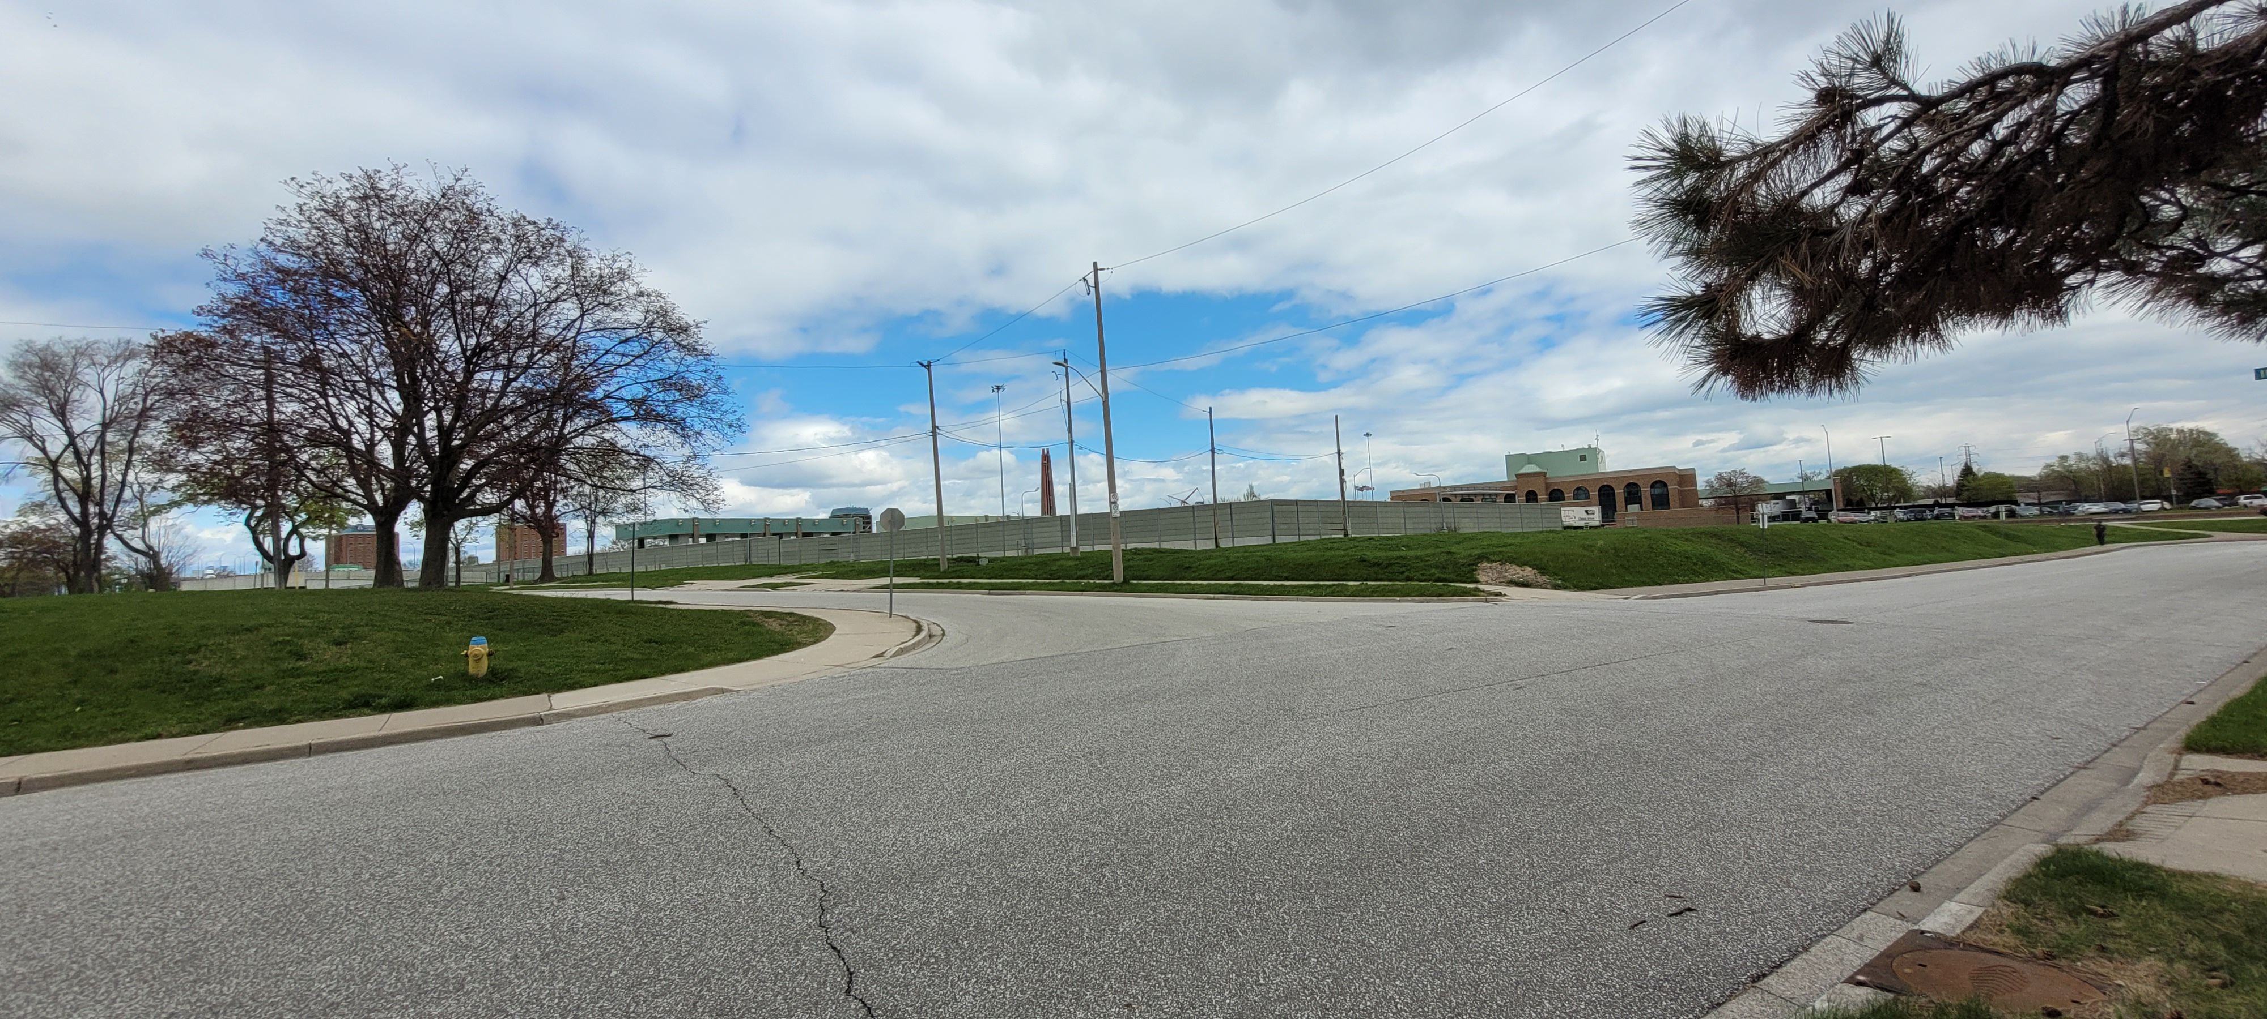
The Requirements
The following are several requirements and negotiation points set out or have been publicly discussed or rumored under the original permit for the twin span, we do not know if these elements remain part of negotiations related to the plaza.
Sandwich Town Community Benefit Fund ~$20 million
Relocate the Fire State from College Ave. to West of Huron Church Road.
Compensate the City of Infrastructure under the bridge/plaza footprint.
Road resurfacing and improvements following full construction.

Slide 4
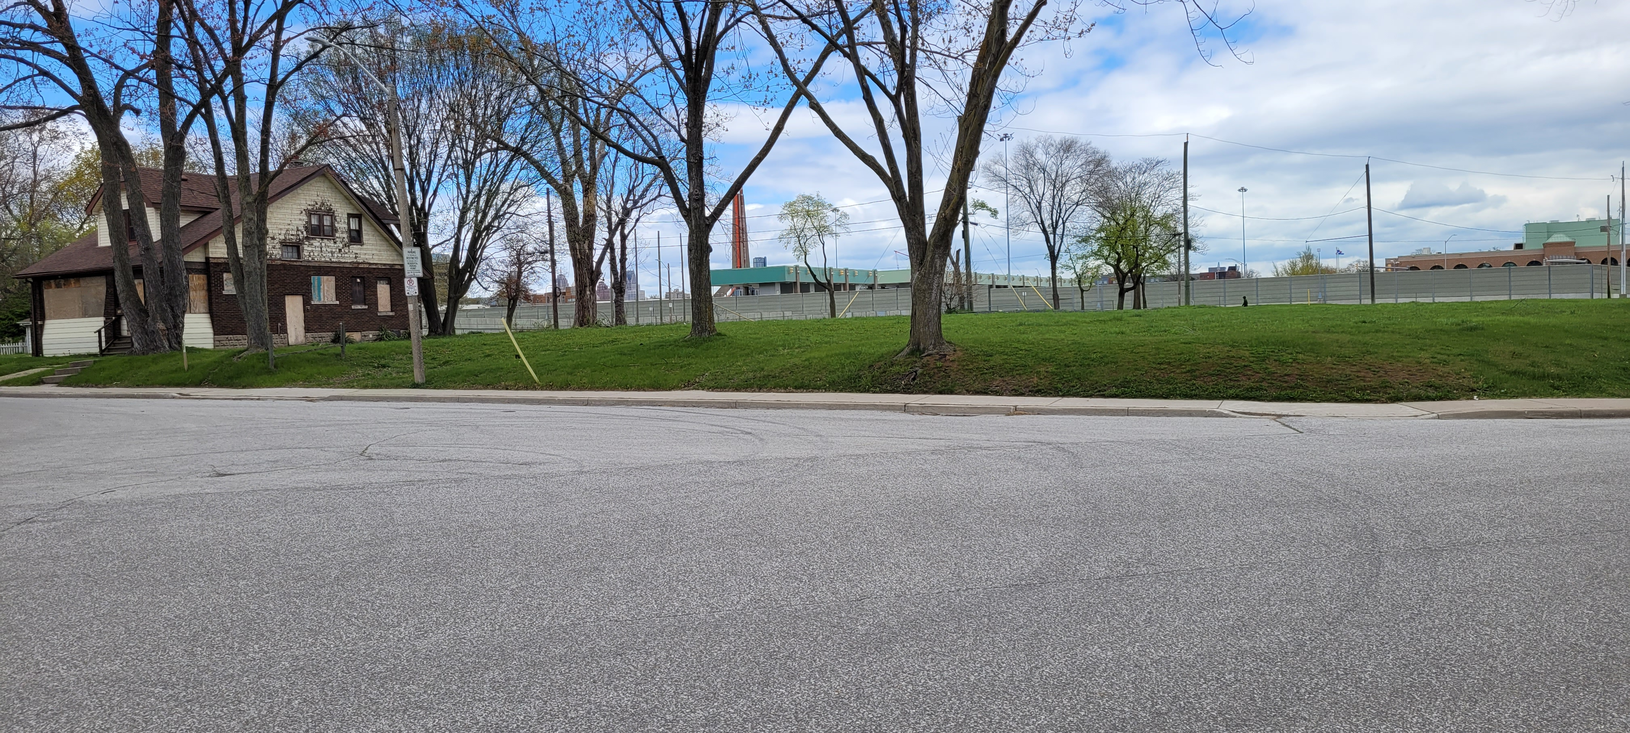
The Requirements
Closing of Donnelly and Peter Street under the bridge to traffic.
Closing of Huron Church Road under the bridge as well as north bound access to Wyandotte St. via Patricia.
Possibly closing Riverside Drive and realignment with University Ave under the Bridge.
Removal residential properties in the footprint of the future span and plaza as well as “buffer” areas.

Slide 5
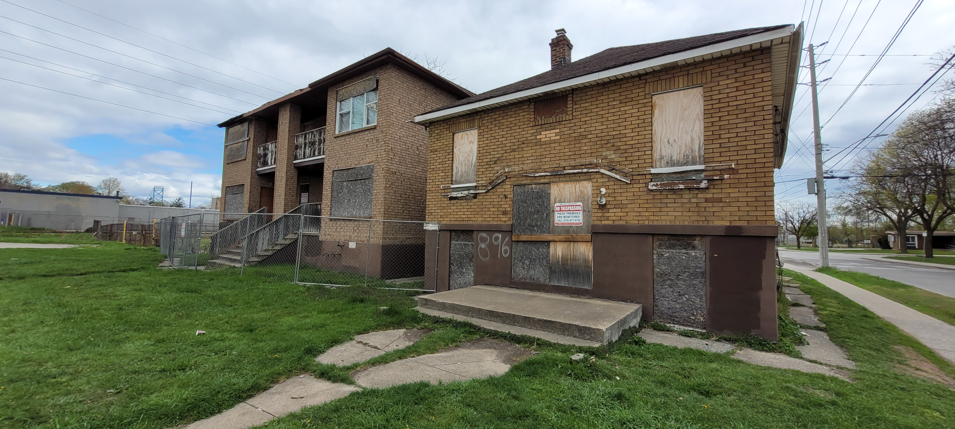
The Other Rumored Requirements or Parts of the Project
Beyond the specifically articulated arguments there is lots of discussion and rumors about other elements at play.
  Many of the boarded-up properties beyond the scope of the plaza go beyond the footprint of the project but have been mentioned as part of land swaps?
  The Abars Properties at the end of Lauzon Road does West End land trade for that?
  The fate/sale of the McDonalds property and whether or not it has occurred?
  Questions about the University’s Label Building?
  A new bypass road on the West-Side of Huron Church?

Slide 6
Let’s Get Windsor Moving Strategy 2004
Projects announced under the LGWEM strategy in 2004 include:
a pedestrian overpass over Huron Church Road south of Tecumseh Road;
intersection improvements on Highway 3 at Walker Road and Outer Drive;
intersection improvements to Huron Church Road at Industrial Drive;
improvements to County Road 19 north of County Road 22 to the VIA Rail Line;
Intelligent Transportation Systems projects including cameras, changeable message signs, and portable message systems;
an Environmental Assessment and Preliminary Design Study to identify improvements to Essex County Road 19;
road-rail grade separations on Walker Road and Howard Avenue at the CPR tracks;
improvements to the Detroit-Windsor Truck Ferry facilities;
improvements to County Road 22;
improvements to Highway 401; and
improvements to the Canadian plaza of the Windsor-Detroit Tunnel.
An update was done in 2008 that began to plan for a new border crossing. This led to the DRIC and the so called Schultz Plan

Slide 7
Implications of LGWMS
This plan had many elements the EA on County Rd 19 (Manning Road) explored the potential widening of that road to 4 lanes – connecting 401 to EC Row.
  This was the foundation for a number study routes for the eventual DRIC project that saw trucks going from 401 down Manning to EC Row then to an eventual crossing point.
  These studies help lead to the basis the Ambassador Bridge Twin proposal with trucks getting off EC Row at Huron Church Road. The Ambas

Slide 8
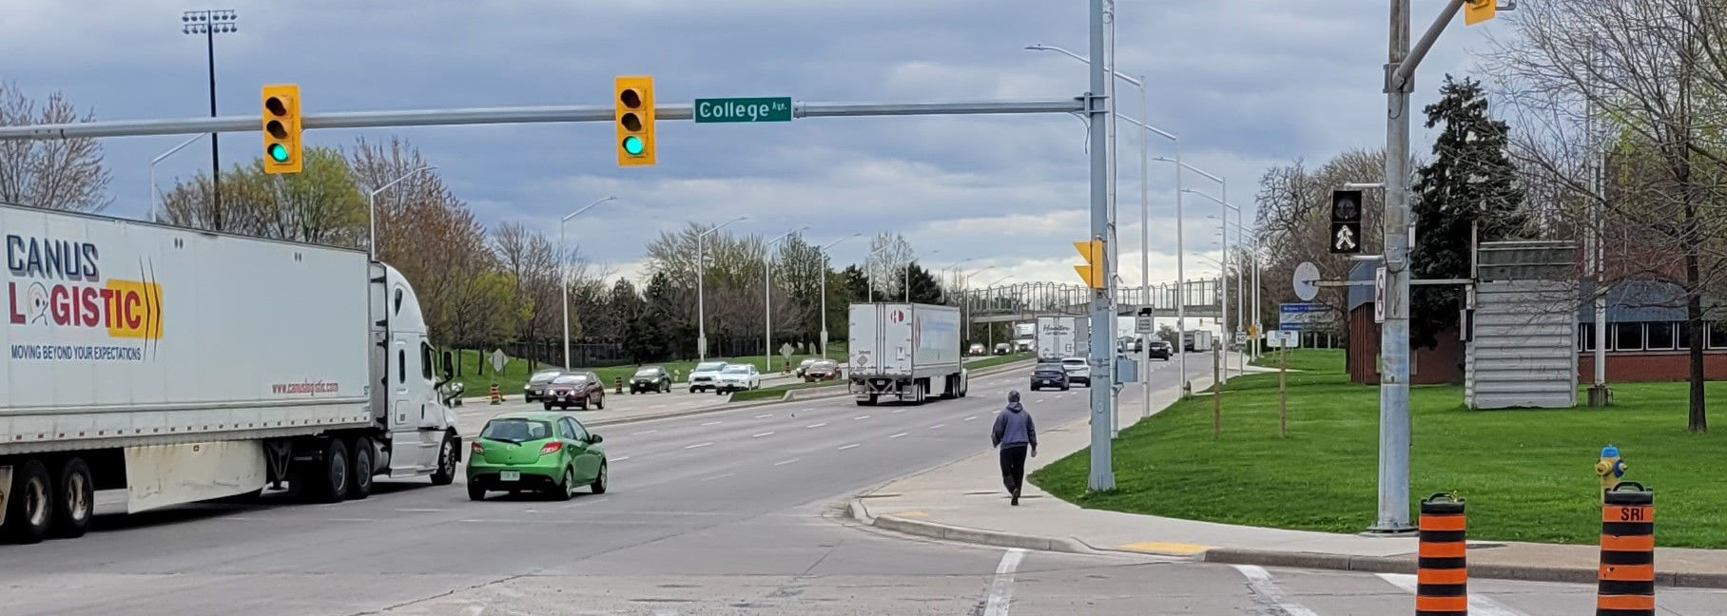
Pedestrian Bridge to Chapter 11 Lawsuit
You will note that in the LGWMS a pedestrian overpass south of Tecumseh Road was proposed. But then ended up across from Assumption High School. Traffic measures like the placement of this were part of the basis of a Chapter 11 NAFTA Lawsuit against the government of Canada.

Slide 9
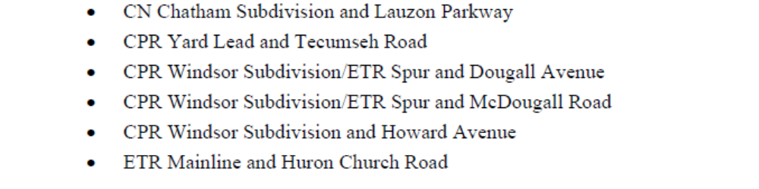
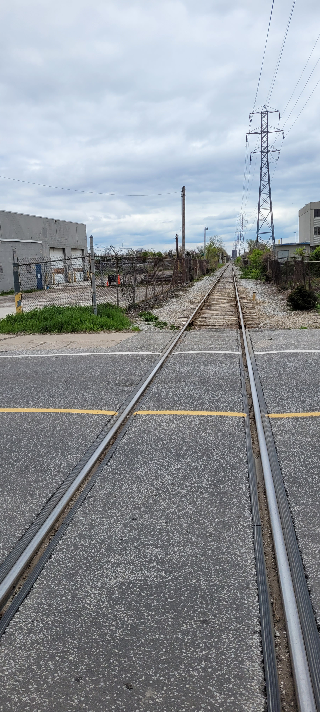
A Train Tunnel/Overpass ?
In 2008 a Community Based Rails Strategy was undertaken by the City of Windsor/Transport Canada that looked at the rail networks in the city and it’s impacts..
In the Strategy they assess which level grade crossing had highest usage and most impact from Rail Transport. The above crossings according to the “exposure index” to justify potential modification from at rail crossing.
  Note Walker Rd was already under construction at the time of the study.

Slide 10
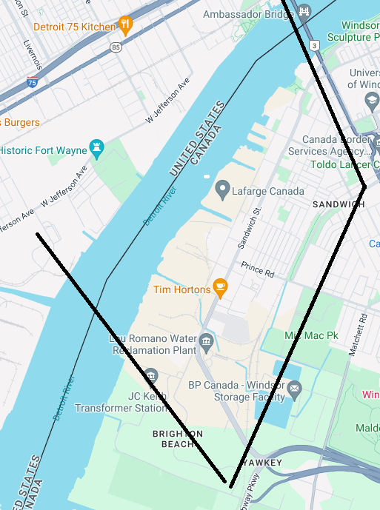
The By-Pass
One of the common theories in the West End is a bypass highway that would create a “Sandwich Town Island” or Sandwich Town would be “Sandwiched” between two bridges and a highway
  A bridge (Gordie) to bridge (Ambassador) with a by-pass highway connecting the two!
The actual by-pass route was never fully articulated in any public planning document (that I could find), but 3 rumored routes certainly have floated through the neighbourhood:
  Down College aver then unclear to where.
  A parallel the ETR Tracks and hydro corridor
  Down Bloomfield Road through the existing neighbourhood

Slide 11
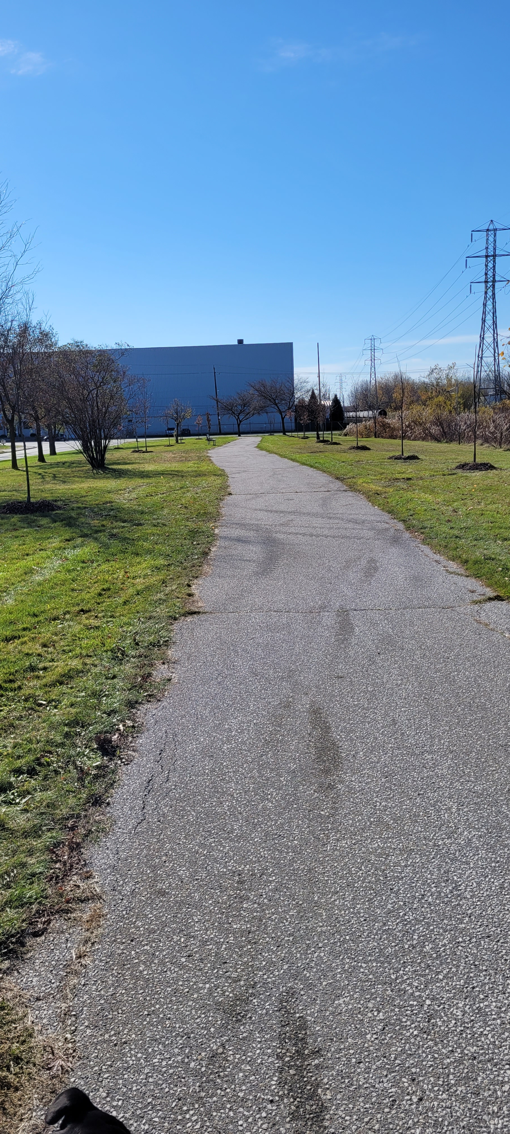
By-Pass College Ave
College Ave is possible but faces challenges.
  Road dead-ends at Prince.
  No signalized intersections between College and HGPW.
Significant investment in park land and WECHC building built

Slide 12
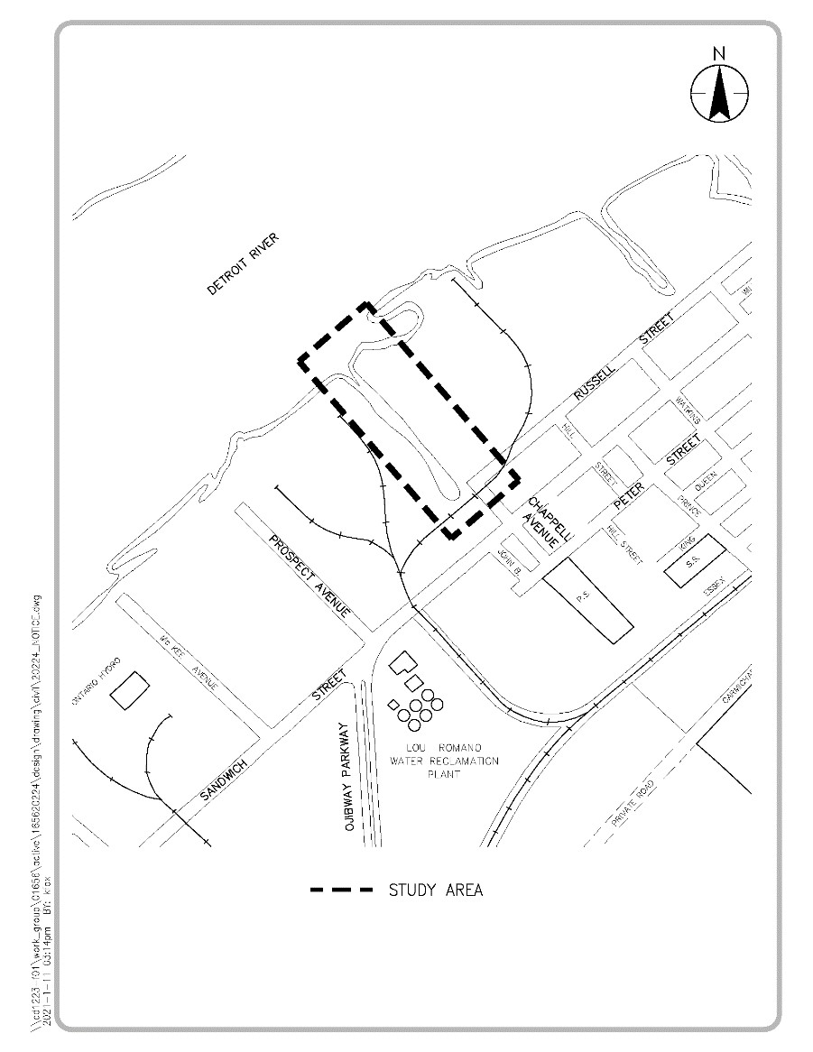
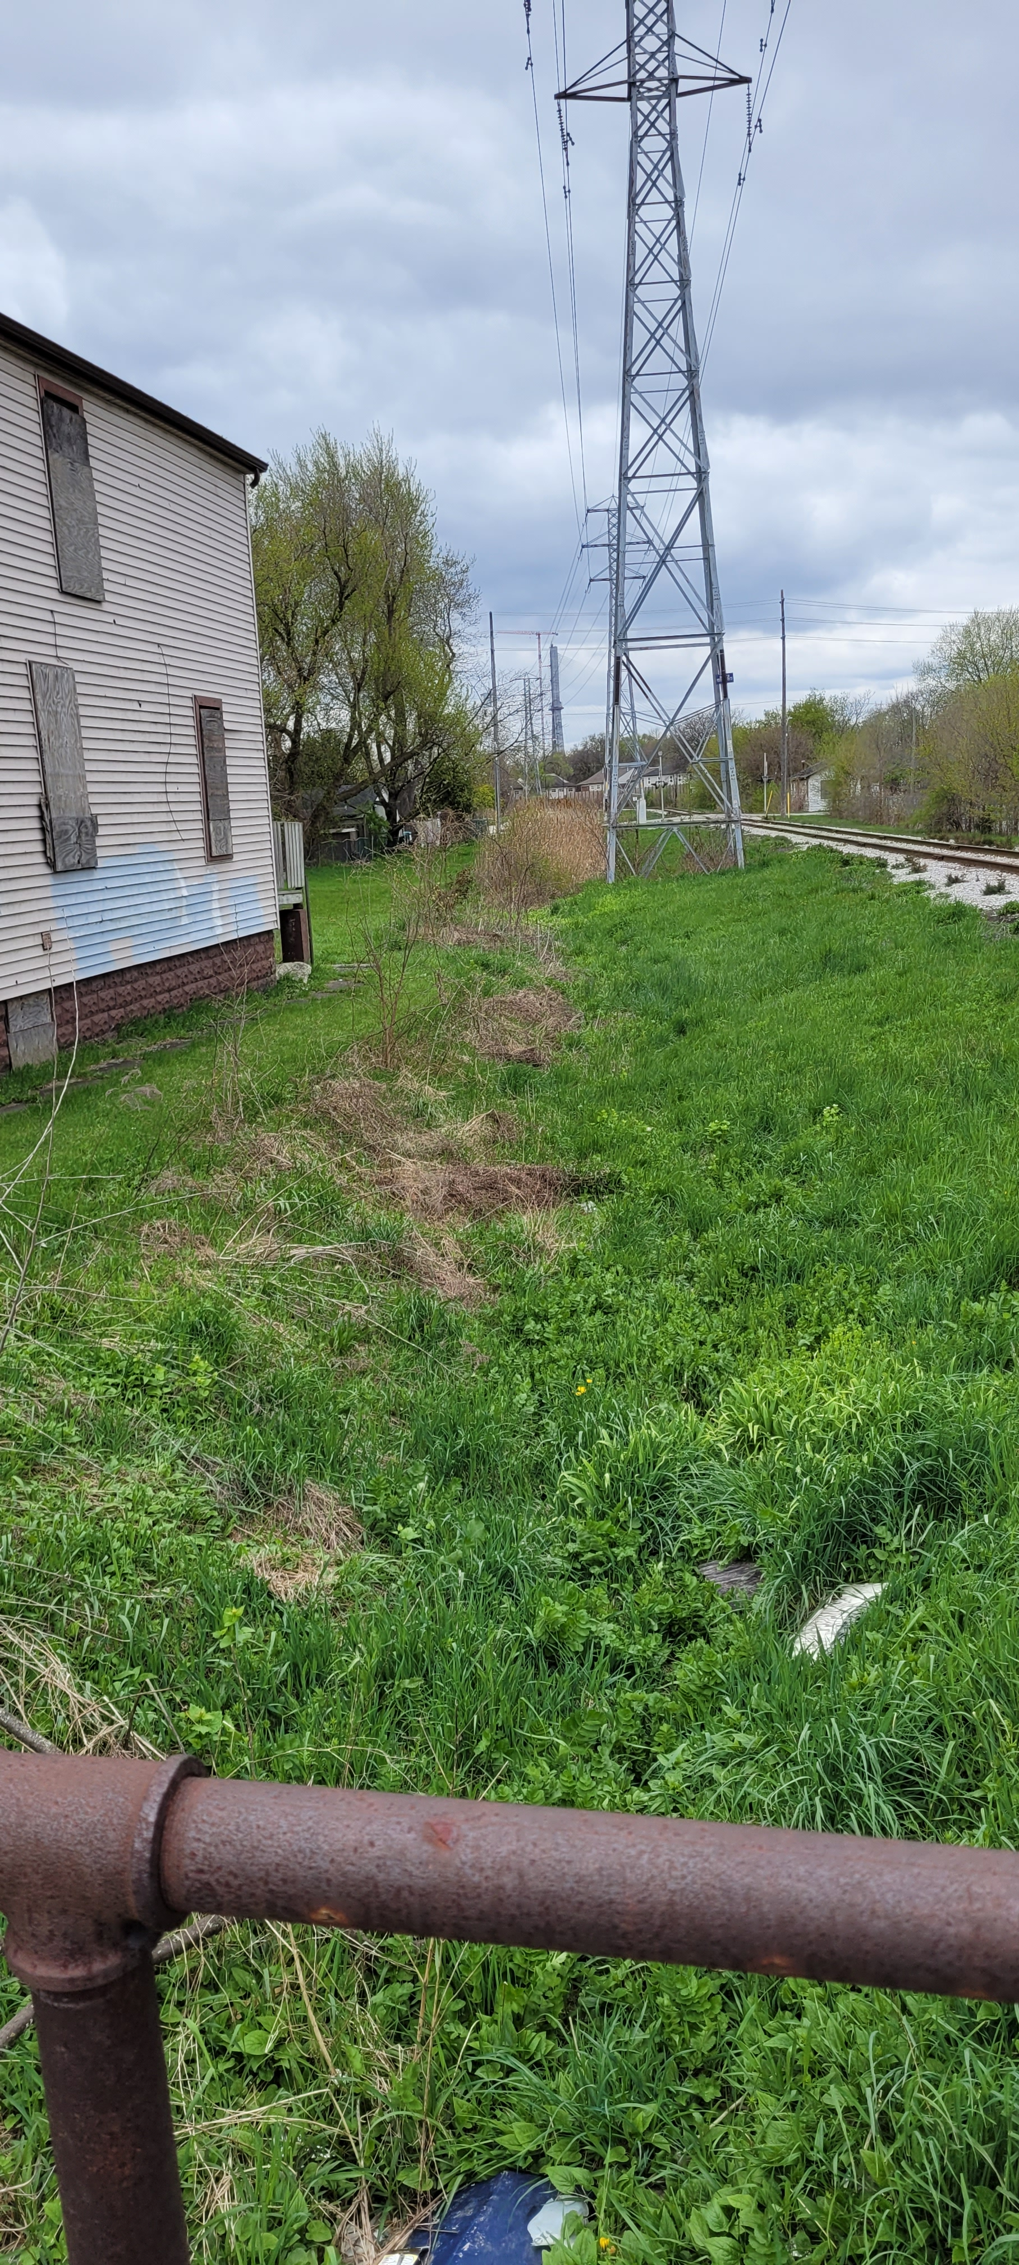
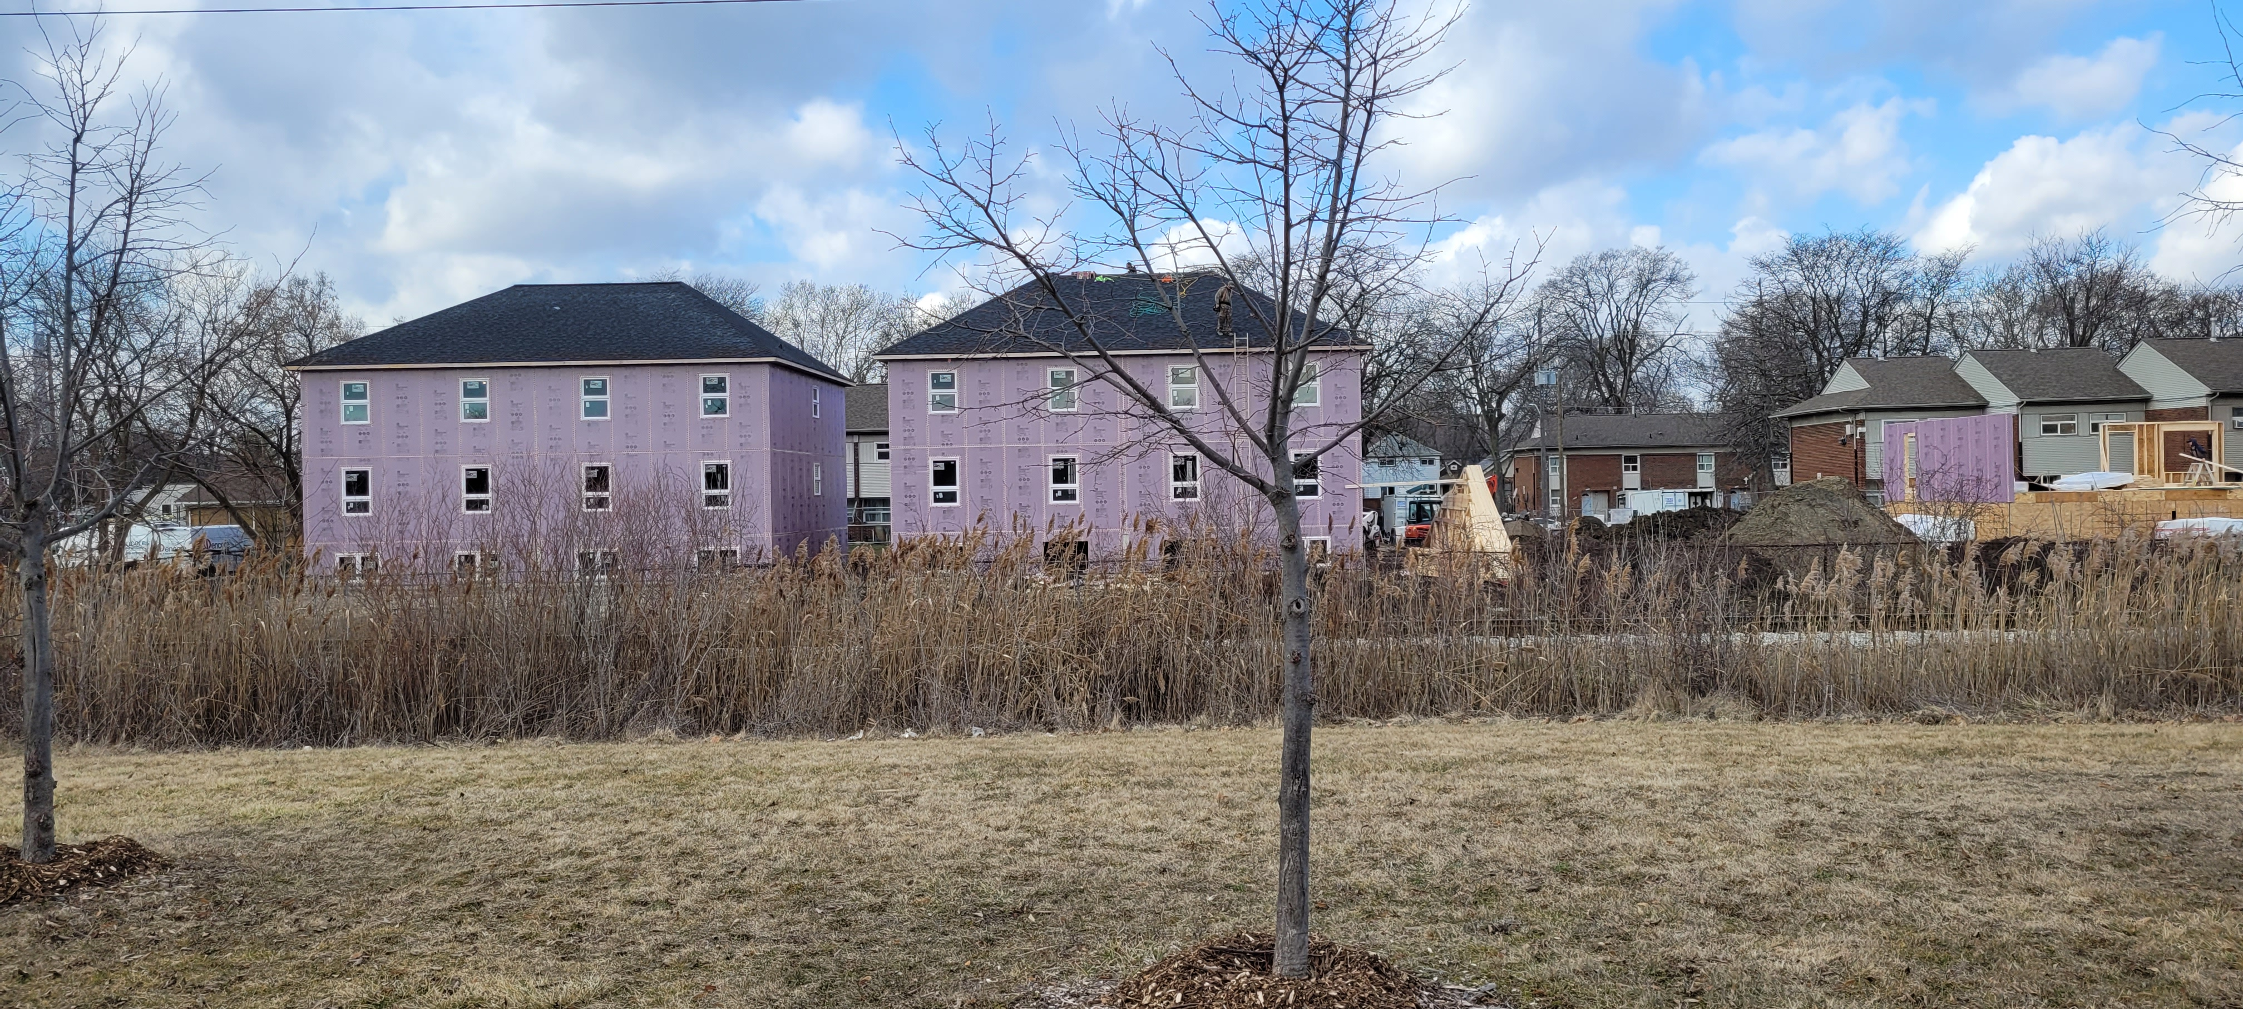
ETR By-Pass/McKee Creek
Some rumors of a truck only road parallel the ETR Tracks.
McKee Creek which runs parallel to the ETR tracks is a major part of the Prince Rd Storm Water Plan. Changes to that creek to accommodate a road would likely require significant stormwater changes for West Windsor.
Buffers also required for hydro corridor.
WECHC new builds adject to ETR tracks

Slide 13
Bloomfield Road By-Pass
Like College Ave and despite owning a number of properties. Bloomfield Road would face significant barriers to becoming a truck route.
The streets connecting to and from Bloomfield are narrow, lack of signalized intersections, and existing residential and CHC properties would be impacted.
  Even with the numerous residential properties on Bloomfield supposedly own by the Bridge it is unlikely that they own enough properties to do a major redesign of the street without expropriating numerous residents as a result numerous buildings sit vacant during a housing crisis.

Slide 14
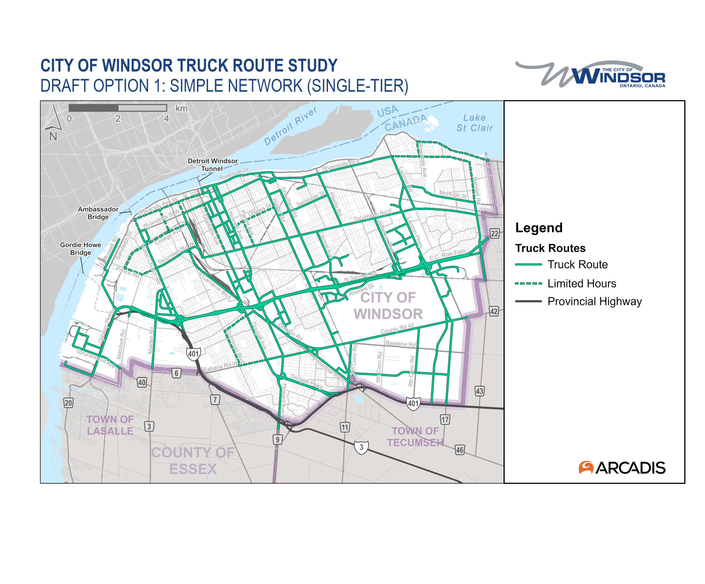
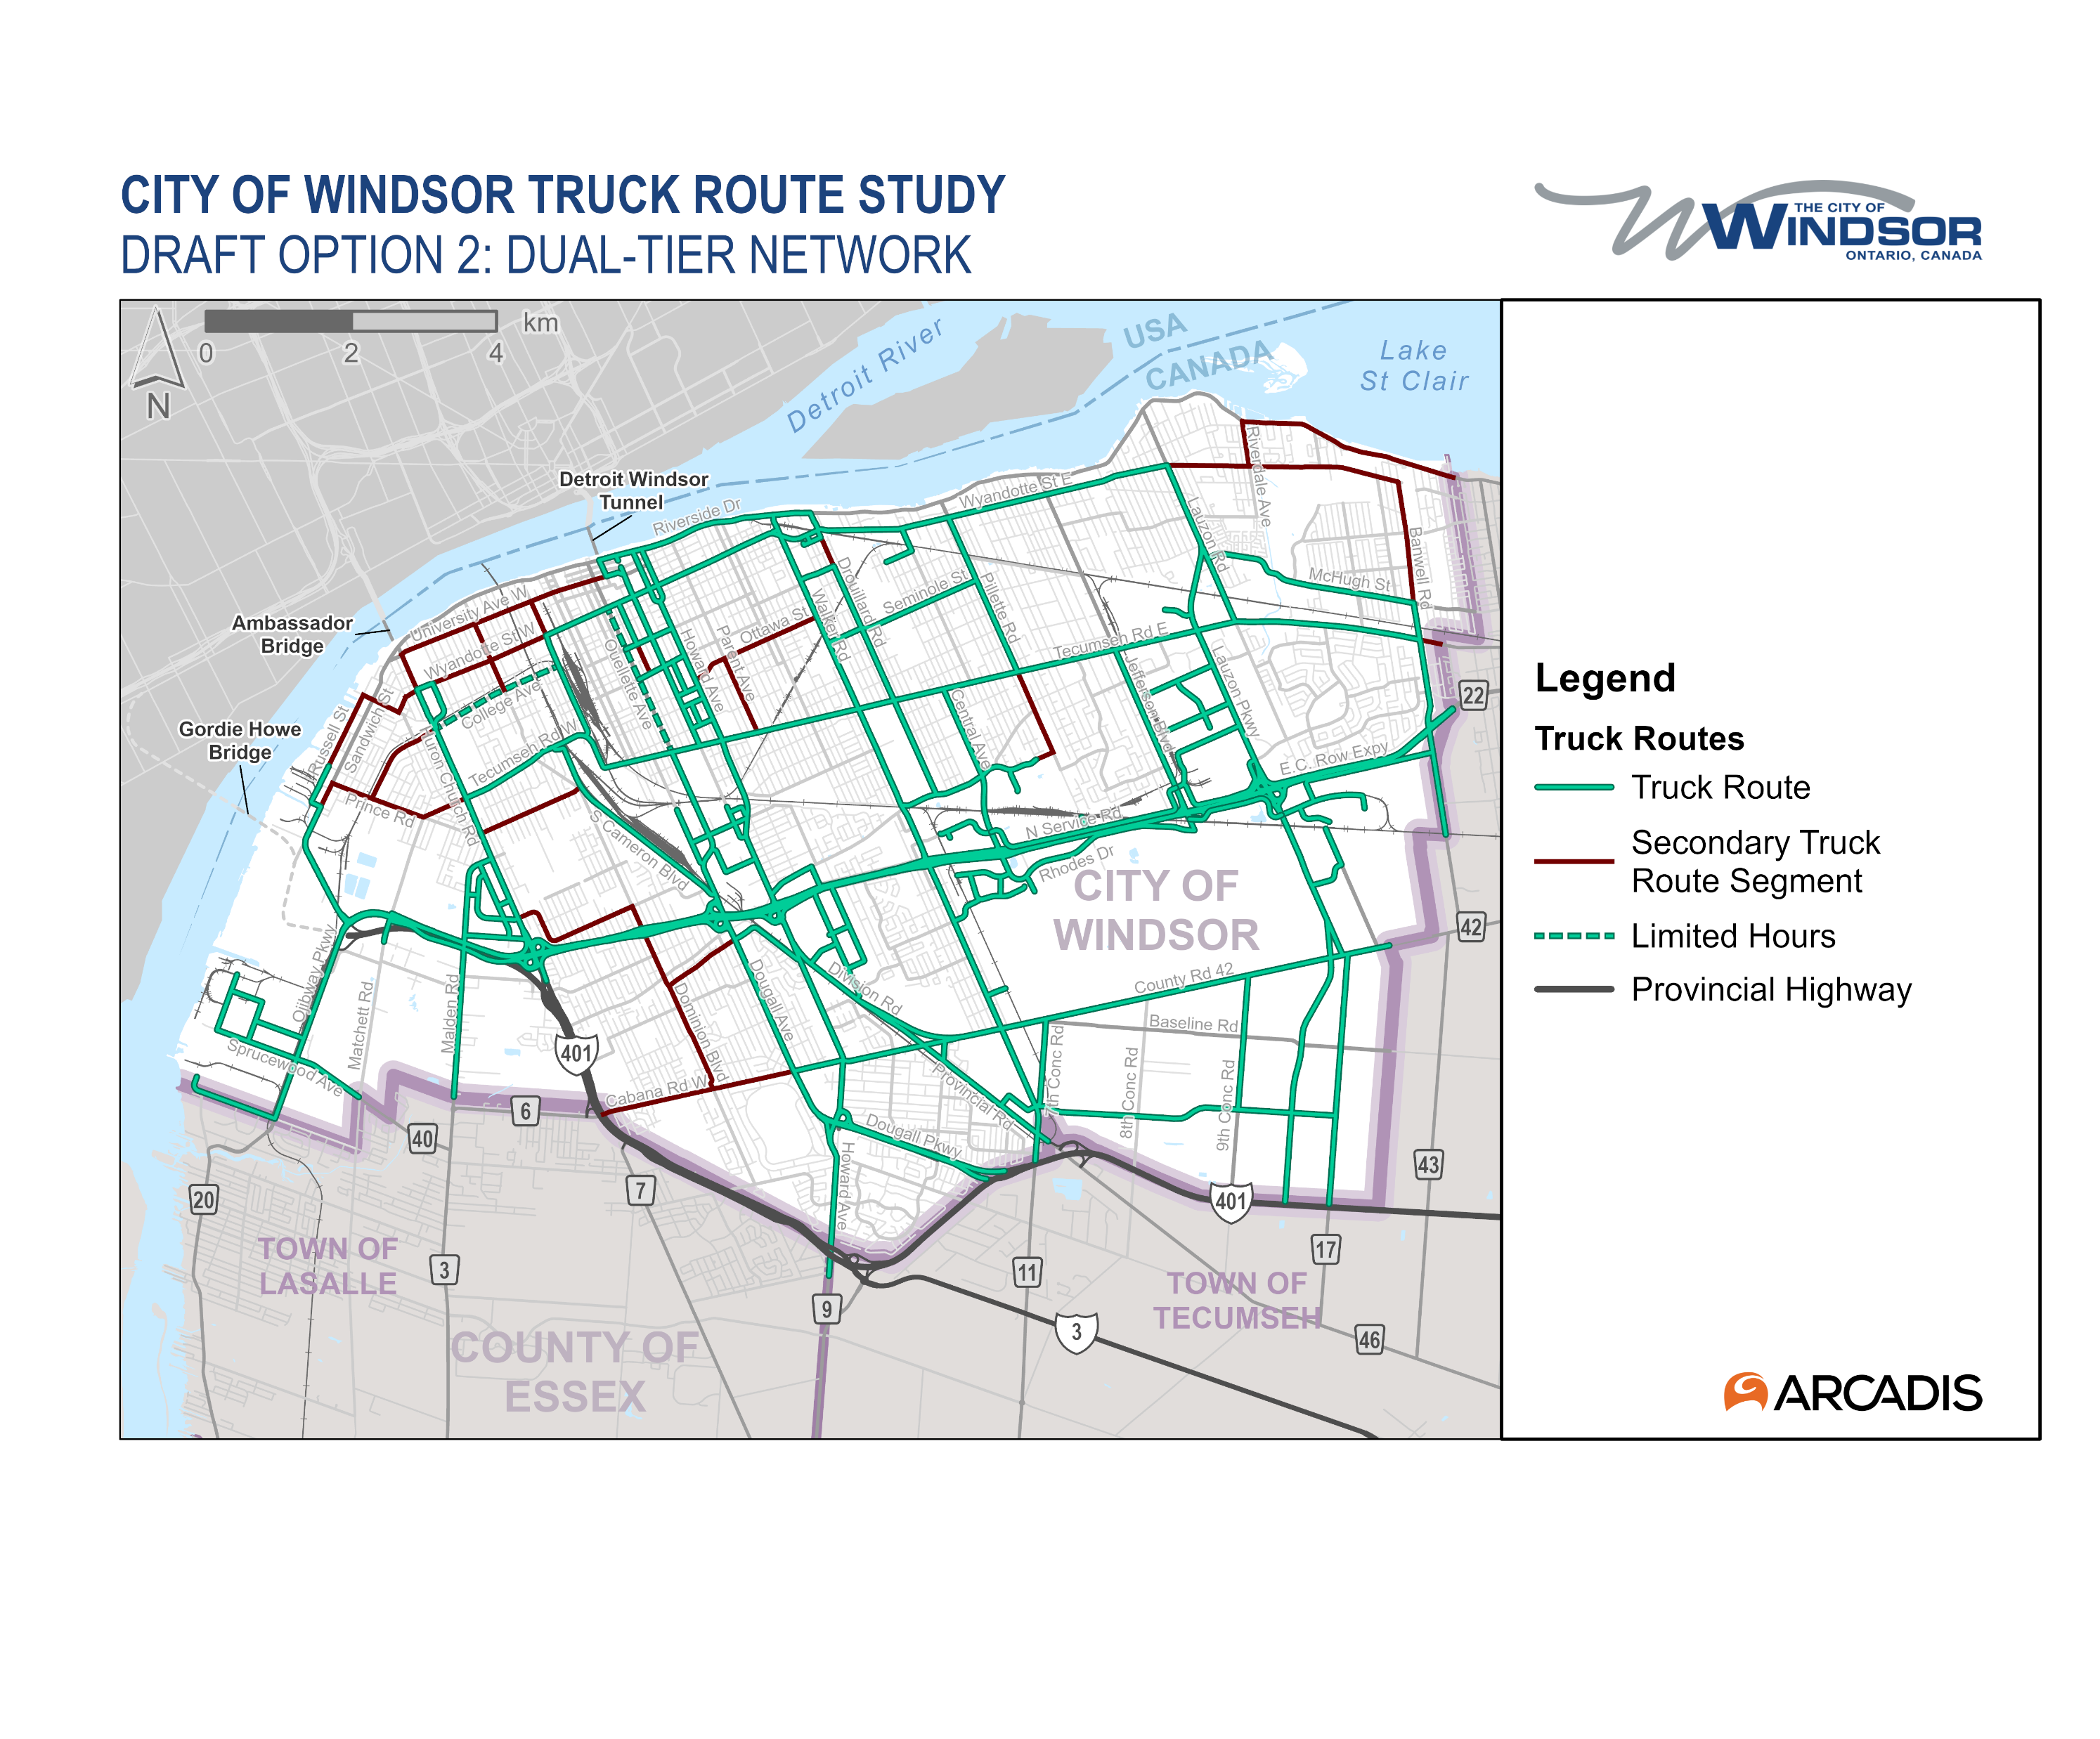
Truck Routes
Truck Route are currently open for consultation here.
Although the maps on are proposed going forward many of the principles that underly these routes would have applied to this by-pass.
  Potential size and scope of the road networks.
  Signalized and right sized intersections.
  Distance from residential streets, schools and other community amenities where possible

Slide 15
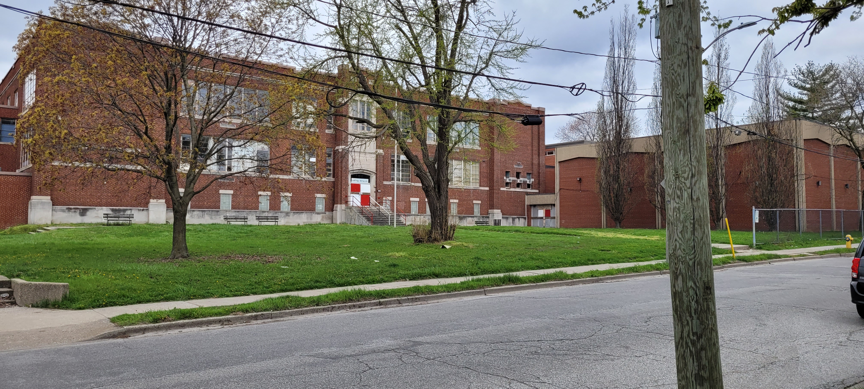
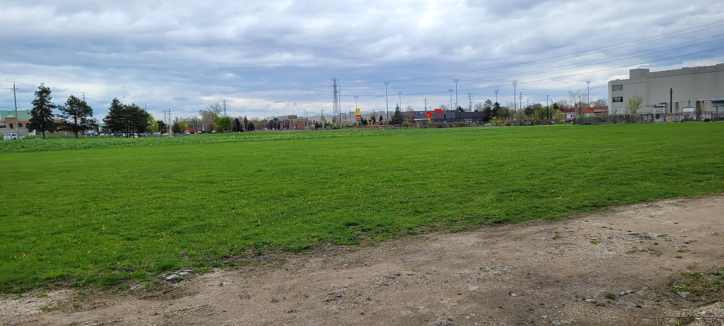
Former Forester
The Forester site is obviously a former anchor in West Windsor.
The football field was acquired as a buffer space between the truck plaza. There is current (not pictured) an air quality sensor on the site likely tracking.
As for the school itself there is currently no public plans for the site. The school would require significant investment if to be re-purposed.

Slide 16
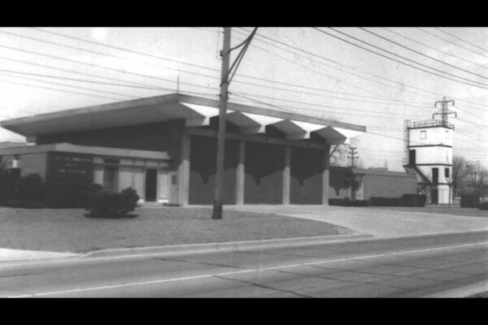
Fire Station Relocation
One of the conditions of the project was the re-location of the fire station on College Ave, to a location west of Huron Church Road. The question is where?
Locations of fire stations are driven by the potential response time from the station as situated in the network.
  Other factors like residential density, road network make up etc.
  Did you know that Fire Station proximity is a major factor in home insurance underwriting in each community?
The limited number of arterial road West of Huron Church potentially limits the potential locations of where a new fire station would optimally be placed. Correlating these locations with Bridge owned properties leaves on a limited number of options.

Slide 17
Source Materials
Orders in Council Searches
  2017-08-31
DRIC Crossing Studies Canada
DRIC Crossing Studies USA
Sandwich Street Reconstruction PIC
Detroit International Bridge Company. v. Government of Canada: In the Matter of an Arbitration Under Chapter Eleven of the North American Free Trade Agreement and the UNCITRAL Arbitration Rules
Get Windsor Moving Strategy 2004 Federal Announcement
  Windsor Gate Strategy 2005 Province of Ontario

Slide 18
Source Materials
Supreme Court Ruling – City of Windsor vs Ambassador Bridge Company
Ambassador Bridge Master Plan – Ambassador Bridge
Environmental Assessment Ambassador Bridge Plaza
Huron Church Road Urban Design Study
Community Based Strategic Rail Study – City of Windsor (link broken)
Prince Road Storm Sewer Outlet EA – City of Windsor Town of Lakeshore fire hall study

Slide 19
Source Material
City of Windsor Response to DRICP (some links have stopped working on City Website.
  Updated Schwartz Report Presentation
Essex Windsor Regional Transportation Plan 2005

